Slide 1
Field Collection Operations
James P. Smith
Supervisory Revenue Officer, Field Collection
June 22, 2016
CPA Continuing Education Society of PA

Slide 2
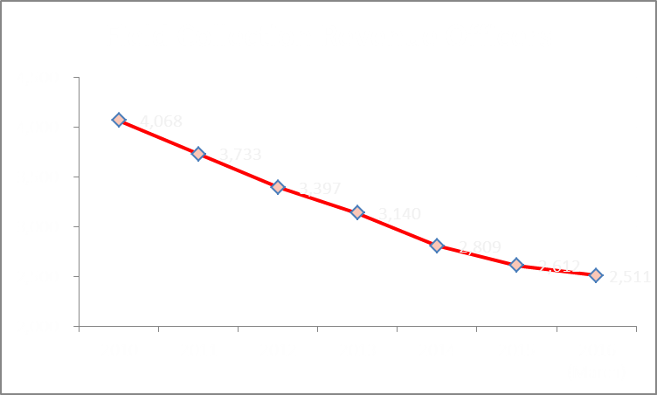
FY 2016 Field Collection Operations
38% Decline

Slide 3
Employment Tax Compliance Efforts

Slide 4
FY 2016 Field Collection Operations
59

Slide 5
FY 2016 Field Collection Operations
$59 Billion
Delinquent amounts due from Forms 941, as of September 2015.
Source: IRS CFO

Slide 6
Why Emphasize Early Interaction
68.6% of 2015 revenue from withheld income & FICA tax
68.3% in 2013
70% in 2012
Big part of Field Collection inventory

Slide 7
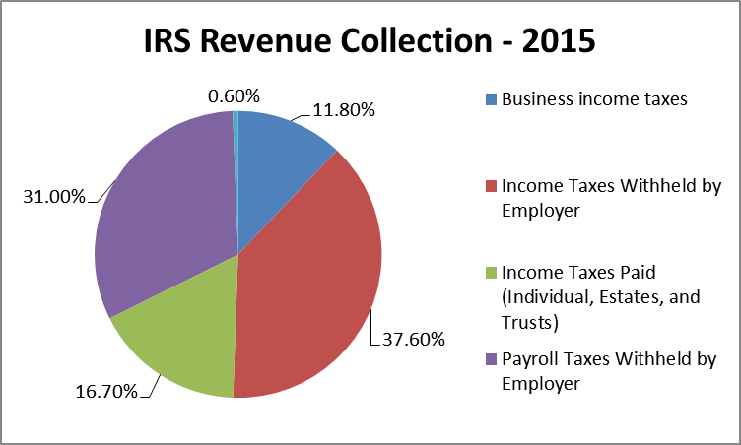
Why Emphasize Early Interaction
Over Two-Thirds Withheld by Employers

Slide 8
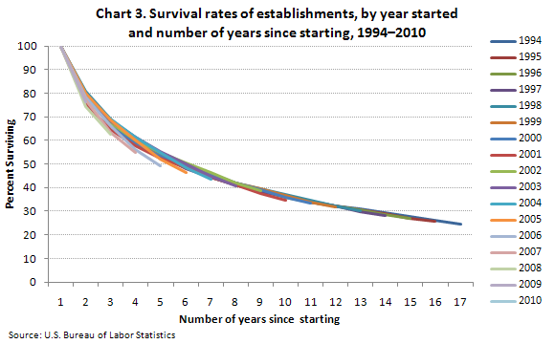
Business Survival Curve
Operating a business is challenging, those not paying taxes withheld in trust gain an unfair advantage over compliant businesses.

Slide 9
FTD Alert Historical Perspective
Federal Tax Deposit Alert (FTD) Program
Started in 1972
Focuses on payroll tax deposits
Identifies changes in deposit history
Assigns an “Alert” to Field Collection

Slide 10
Early Interaction Initiatives Federal Tax Deposit Alert System
FTD Alert X Coded Pilot
Tests whether accelerating the timing of alerts increases impact and identifies which taxpayers benefit most from alerts
Implemented: April, 2015
EFTPS Early Alerts
Modifies the FTD payment platform to create a near real-time system to identify variances in FTDs that will enable/expand treatment streams
Initial Implementation: 2016
Fully Operational: 2017

Slide 11
Early Interaction Initiatives Benefits
Expand early interaction program, educate taxpayers and modify taxpayer behavior to enhance compliance
Improve collection case selection and assignment
Enable data-driven decisions regarding taxpayer contacts

Slide 12
Outsourcing Payroll
Many employers outsource some or all of their payroll and related tax duties to third-party payroll service providers.
Third-party payer services include:
Withholding Social Security, Medicare and income tax from wages
Timely submitting federal tax deposits
Preparation and timely filing of payroll tax returns
Preparation and timely filing of information returns

Slide 13
Risks of Using Third-Party Payers
In rare instances use of a third-party payer can expose a business to risk of:
Payroll tax fraud
Late or unfiled tax returns
Underreported tax liabilities
Late or undeposited tax payments
Limited notification if a problem arises

Slide 14
Initiatives to Mitigate Risks of Using Third-Party Payers
Dual Notice Initiative – Risks associated with address changes
Electronic Federal Tax Payment System enhancements
Inquiry PINs
Email confirmation of scheduled payments

Slide 15
Initiatives to Mitigate Risks of Using Third-Party Payers
Creation of Form 14157, Return Preparer Complaint
Used by taxpayers to report suspected fraudulent activity and abusive tax schemes
Federal Tax Deposit Alerts
Early Interaction initiatives
Trust Fund Recovery Penalty - IRC § 6672
Assessing the Third-Party Payer

Slide 16
Enforcement for Non-Compliant Employers
Levy of bank accounts, receivables
Seizure of property
Disqualified Employment Tax Levy (DETL)
Trust Fund Recovery Penalty (IRC 6672)
Suits for Injunctive Relief
Criminal Referrals

Slide 17
Final Thoughts - Compliance
Case Resolution Prerequisites
Compliance today
Compliance tomorrow
Compliance in the future
No current/future compliance = No easy resolution
Future compliance is the key to resolving past non-compliance.

Slide 18
Field Collection Operations
Questions?

