Slide 1
Local Tax Overview
Earned Income Taxes
Act 32 – Act 18
Local Service Tax

Slide 2
Employer requirements
Employers are required to register each of their work sites with the collector for that tax collection district.
Collector will provide unique identifier for each location to be used to file under.
Employer is required to obtain a Certificate of Residency for each employee of location. And retain it on file.
Tax rates used for withholding are to be verified bi-annually. (Jan. 1 and July 1).

Slide 3
Employer Withholding Requirements
There are two tax rates that an employer must consider when calculating the proper amount of tax to withhold. They are based on the DCED’s Official Tax Register.
The employees resident tax rate or,
The non-resident tax rate for the jurisdiction where the business is located
If a community where a person works has a non-resident tax, and that tax rate is higher than the tax rate where that person lives, the community where he or she works is entitled to the difference.

Slide 4
Employer filing requirements
Employers who have furloughed their employees to work from home due to COVID-19 are required to register the employee’s home as a work site if:
Work assignment has been for a period exceeding 90 days even if considered temporary
Or if the change has been made permanent for the foreseeable future.
This requirement applies to employers located in the City of Philadelphia as well.

Slide 5
Employer filing requirements
Employers must file a quarterly return and are required to pay the amount of tax withheld during the preceding period at that time.
Businesses with places of employment in multiple counties can choose to submit all of their withholding information and payments to one county collector, to do so the employer must agree to:
Give 30 day notice to the Collector they intend to file with
Notify all of tax entities it has locations in of their intent to file one consolidated return
file electronically
file every 30 days

Slide 6
Employer Filing requirements
Employers must provide:
Each employee’s name, address, and social security number. (Address cannot be a PO Box, must be street name and house number)
Each employee’s compensation during prior 3 months. (Or the prior month if using statewide option)
Tax amount deducted from each employee.
Provide the proper Political Subdivision Code for each employee.
Notes:
6

Slide 7
Employer filing requirements
Employers must provide
If an employee moves during the reporting period, the employer will need to list the employee’s wages attributed to each PSD separately on the return filed.
Beginning with the 2018 Tax Year, the information to be shown in the “Locality Box” on the W-2 will be the 6 digit PSD code for where the employee was employed for the wages shown. If the filer is utilizing the statewide option, they will be required to provide the 2 digit County code to whom the funds were sent to as well.
Notes:
7

Slide 8
W-2 Information
Information in Box 18 should indicate total wages paid in 2022 as reported to PSD # shown in Box 20
Box 19 should indicate taxes remitted to the county collector for PSD # in Box 20
Information to be placed into Box 20 of the 2022 W-2 is to be the 6 Digit PSD # of the location that the wages are attributed to.
If taxpayer had funds submitted for work in multiple PSD #’s (such as in wages reported to City of Philadelphia) these must be shown as separate line items or on separate W-2’s.
For employers using the statewide filing option they must also include 2 digit county code funds sent to as well. (Example – Wal Mart W-2: 460101-46)

Slide 9
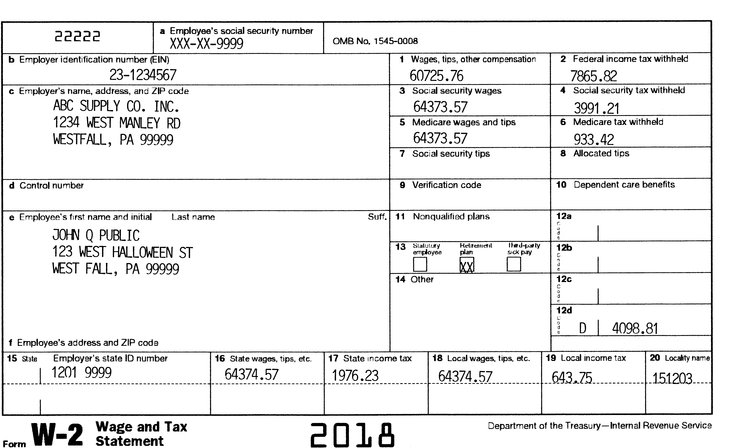

Slide 10
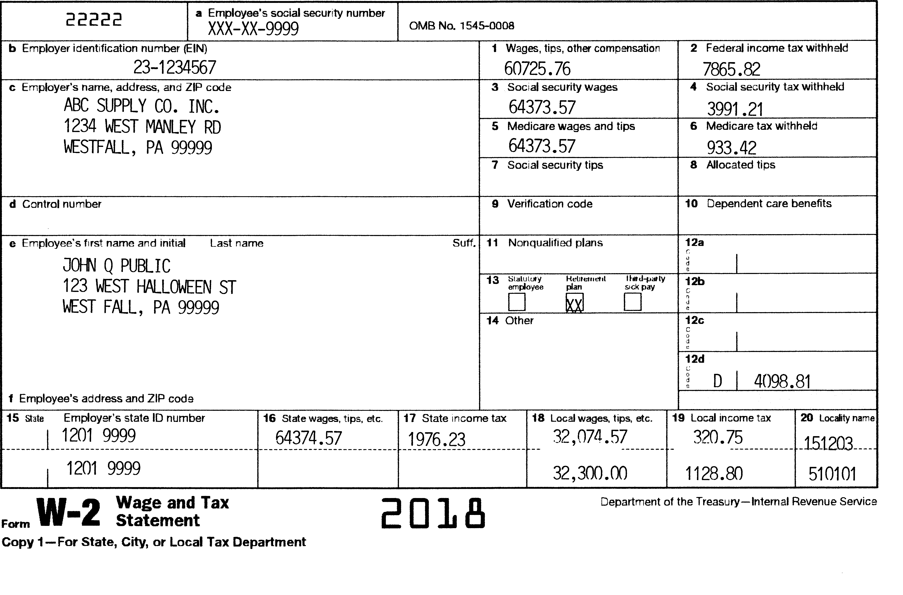

Slide 11
Individual Filings
Local filings are due on same date as Pennsylvania annually.
Local returns are filed as individuals so spouse’s income, withholdings and credits must be reported separately.
Definitions of Earned Income and Net Profits mirror those of PA, so if taxable to PA, taxable locally. The exception is Clergy Housing allowance. Which is taxed by PA but is not taxed locally.
Individuals may not utilize Net Losses from the operation of a business as an offset against W-2 wages earned. (Follows the same rules as PA)

Slide 12
Individual Filings
When filing a local return taxpayers are required to include the following information along with the return:
W-2 forms – listing local taxes being claimed
Supporting schedules for Net Profits/Losses reported
Copy of Non-resident Tax returns for non-reciprocating states for which credit is taken.
Copy of ACT 172 Volunteer Form if Credit is used.

Slide 13
City of Philadelphia – Wage tax
Credit for taxes paid (wage and/or net profits) to the city are eligible to be applied to taxes due on the taxpayer’s wages/net profits earned regardless of where those wages were earned. This credit is often referred to as a “Super Credit”.
They may also be applied against all tax types (Open Space/Occupation Elimination and Distressed) the taxpayer is subject to.
This credit cannot be transferred to a spouse.

Slide 14
City of Philadelphia – Wage tax
Note – If taxpayer intends to seek refund of taxes paid to Philadelphia due to being required to work from home due to COVID-19. They should not include the refund amount as credit against taxes.
Only the amount that will remain in the city for 2022
will be eligible for use.
If Employer is/was required work from home and the employer is not withholding local taxes due their home juris, taxpayer is responsible to pay quarterly.

Slide 15
City of Philadelphia – Wage tax
Gross Income (1) $100,000.00
Wages Taxed in Philadelphia $ 70,000.00
Local Tax 1% x .01 (2) $ 1000.00
Tax paid to Philadelphia (3) $ 2425.50
Credit to be used against Local Tax (4) $ 1000.00
On Line 10 of the tax return, enter this amount (4)
or the amount on Line 2 of worksheet, whichever is less
If the taxpayer has also paid local taxes and the total credit due (city credit + PA local taxes) exceeds their tax liability, the taxpayer is eligible to receive a refund up to the PA local amount paid.

Slide 16
Out of State Credit
With the passage of ACT 18 of 2018, Out of state credits may now be applied to Open Space Taxes (ACT 153), or Occupational Elimination Taxes (ACT 24/130).
This change applies to Tax Year 2018 and forward only.
Out of State Credits are still not permitted to be applied to taxes levied under ACT 1 - Real Estate Reduction Taxes that are levied by a number of School Districts in the Commonwealth. In those areas credits are still capped at the tax rate not attributed to this levy.

Slide 17
Out of State Credit
Example based on tax rate due Skippack Twp/ Perkiomen Valley SD where rate is 1.65% (1% - ACT 511 - .25% - ACT 153 and .4% - ACT 24)

Slide 18
Act 172 of 2016/Act 191 of 2020
Gives municipalities the right to provide a credit to resident volunteers who meet the criteria that has been established to qualify. (i.e. based on service time and # of calls responded to.)
The credit in most areas is restricted to municipal portion of taxes levied under Act 511 only. Unlike Out-of-State credits this one cannot be applied to Open Space or Occupation elimination levies in place.
School District’s (Act 191) now have the ability to agree to allow the credit on their portion of Act 511 taxes as well.

Slide 19
Act 172 of 2016/Act 191 of 2020
Qualifying volunteers will receive certificate of eligibility from their organization.
The form details maximum credit allowed and tax rate it can be applied to. It must be signed by an authorized representative of the volunteer organization and a representative of the taxing jurisdiction.
Form needs to be included with filing for the year it is earned in.
Credit given cannot exceed taxes paid to resident municipality and cannot be transferred to spouse.

Slide 20
ACT 172 Sample

Slide 21
Credit Calculation where work rate is greater than home rate
Non-resident rate higher than home location.
Credit to be inserted on line 9 of local return is found in column 7 of the worksheet.

Slide 22
ACT -18 Changes Individual Filings
Individuals who have $0 income to report are exempt from having to file a final return with the collector. (If taxpayer had earnings in prior year and $0 in current they must file that year stating why)
Tax administrators now have the right to abatement penalties and interest with approval of their client tax collection district.
All collectors must use the DCED approved forms in their exact format for Tax Year 2020 and forward.

Slide 23
Errors from the Field
Common errors seen
Taxable amounts reported to PA for early distributions from a retirement account (1099-R), not included on the local return. Since PA considers this income, it is taxed locally as well.
Requests for refunds on taxes withheld in work location that exceed the taxpayers resident tax rate. Funds remain in work location. If withheld in error – letter from employer stating such is required.
Taxpayers on extension have not notified collector of this fact.

Slide 24
Local Services Tax
Based on where employee physically reports to work each day or where EIT withholdings are attributed to.
If employee is now assigned to work from home and has done so for 90 or more consecutive days, their home is their work location.
As with EIT – Employer would be required to register the employee’s home as a work location and remit the tax based on that fact.
This change may require employer to register with a collector other than the EIT administrator for this tax type.

Slide 25
Local Services Tax
If the tax rate is greater than $10.00, taxes is withheld on a weekly basis and remitted quarterly.
Rates greater than $10.00 require that the municipal portion have an income exemption of $12,000 per annum.
Income is based on earnings in that location only.
Employee is required to file Exemption form stating they will not make more that $12,000 in area.
If school district shares the tax, income exemption for their portion is based on their enactment. So employee may be exempt for municipal portion, but still owe SD.

Slide 26
NEW FEATURES! Welcome to the BerkApp
Berkheimer Tax Innovations has been hard at work developing an exciting new mobile app to help make filing your local taxes easier and more convenient than ever. New features on our mobile app are now LIVE!
New Features:
If you need to respond to a correspondence or inquiry from our office, you can simply type in a quick response and take a pic of the correspondence and any supporting documentation that has been requested. No need to write a letter or physically send in documents. Quick and easy is our goal.
If you have received a balance due letter or delinquent tax notice from us, you can now pay it through the app.
The App currently supports two types of filers:
If you have just a W2 and no other Schedules or Forms, you can easily file by just taking a picture of the W2 and entering a few fields. This should be a quick and easy way to file.
If you have a completed paper return that includes any type of schedule or form, you can use your phone or tablet to take pictures of each page and upload them as your filing.
If you moved during the tax year or lived out of state, then unfortunately you cannot file using the app at this time.

Slide 27
Berk-APP

Slide 28
Contact information
James Hunt, Director of Governmental Relations
Berkheimer Tax Innovations
50 N. Seventh St.
Bangor, PA 18013
(800) 360-8989 ext. 2156
(610) 588-5765 (fax)
jhunt@hab-inc.com
www.hab-inc.com – ACT 32 Information

